Slide 1

Neural Connectivity Differences in Psychosis: A Biotype-Specific EEG Analysis
Division of Psychiatry
MRes Brain Sciences
Research Project
Author: Liu, Haoming
Supervisor: Adams, Rick
Rodriguez Sanchez, Julia

Slide 2
Psychosis
Spectrum of Symptoms
Schizophrenia
Schizoaffective disorder
Bipolar disorder
Persistent Psychosis: Chronic hallucinations and delusions.
Cognitive Decline: Significant impairment in memory and focus.
Dual Symptomatology: Combination of psychotic and mood disorder symptoms (Mania or depression).
Mood Episodes: Periods of depression or mania that can affect functioning but are intertwined with psychotic symptoms.
Episodic Mood Swings: Intense emotional states ranging from manic to depressive.
Cognitive Effects: Occasional trouble with attention and executive function.

Slide 3
Psychosis
Subtypes based on Biomarkers
Mismatch Negativity
Cognitive Control
Biotype 1
Biotype 2
Biotype 3
Clementz, et al. (2016)
EEG
Event-Related Potential
……
Clementz, B.A. et al. (2016) ‘Identification of distinct psychosis biotypes using brain-based biomarkers’, American Journal of Psychiatry, 173(4), pp. 373–384. doi:10.1176/appi.ajp.2015.14091200.

Slide 4
Hypothesis in Psychosis
Aim
E/I Imbalance Hypothesis:
Imbalance between excitatory and inhibitory signals in the brain.”
Disruptions in this balance can lead to abnormal neural circuit function, contributing to psychotic symptoms.
Understand the biotype-specific brain activity patterns through various EEG analyses,
Explore the potential role of microcircuit connections in explaining observed EEG differences across biotypes.
Examine how changes in neural circuits contribute to the Excitation/Inhibition (E/I) Imbalance and psychosis.

Slide 5

Data Availability
B-SNIP Resting-state EEG
(Bipolar – Schizophrenia Network on Intermediate Phenotypes)
Healthy Control
(n = 236)
Biotype 1
(n = 167)
Biotype 2
(n = 135)
Biotype 3
(n = 131)
Participants
Patients
(n = 484)
Relatives
(n = 538)
About B-snip – B-snip. Available at: http://b-snip.org/about-b-snip/ (Accessed: 06 September 2024).

Slide 6
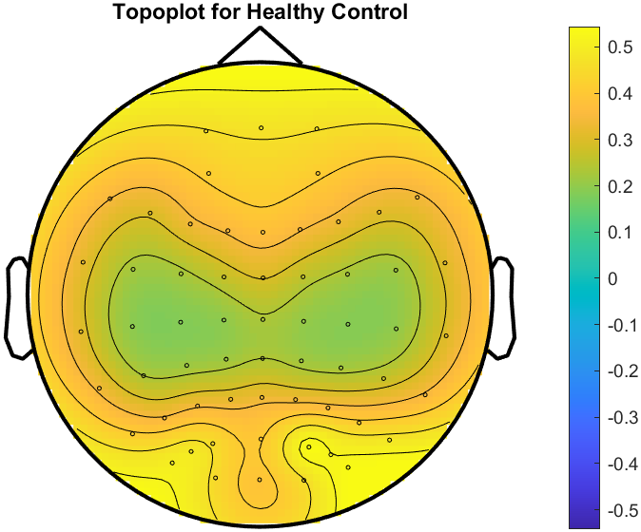
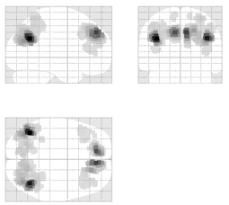
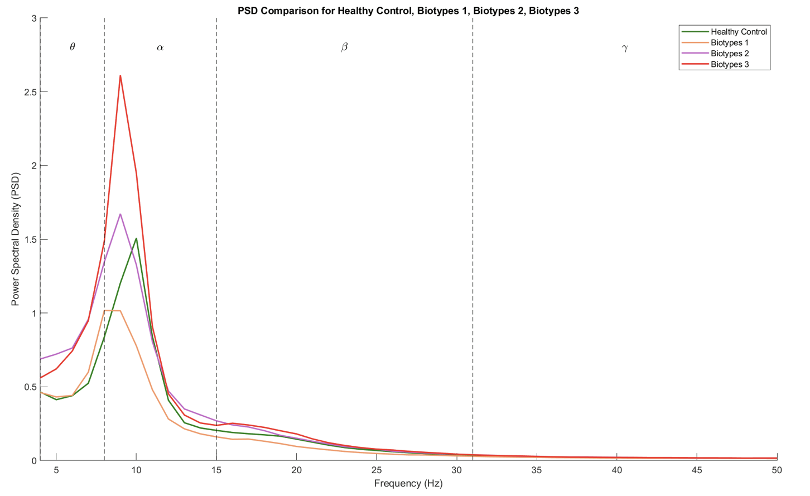
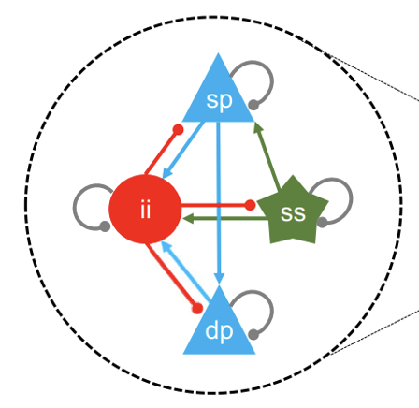
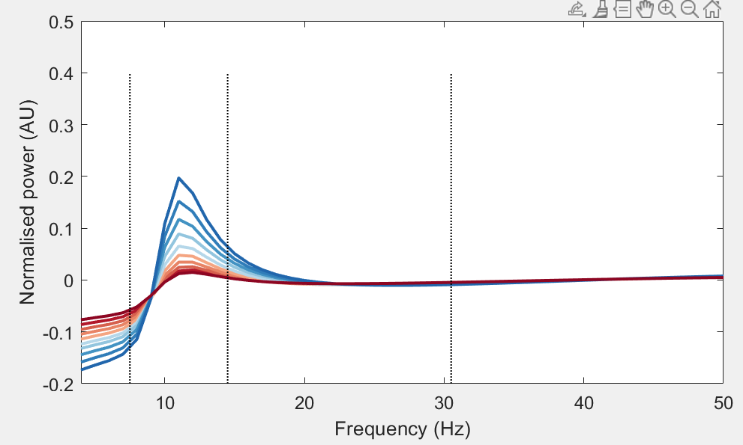

Methods
Power Spectrum Analysis
Topographic mapping
Source Reconstruction
Dynamic Causal Modelling
Simulation

Slide 7
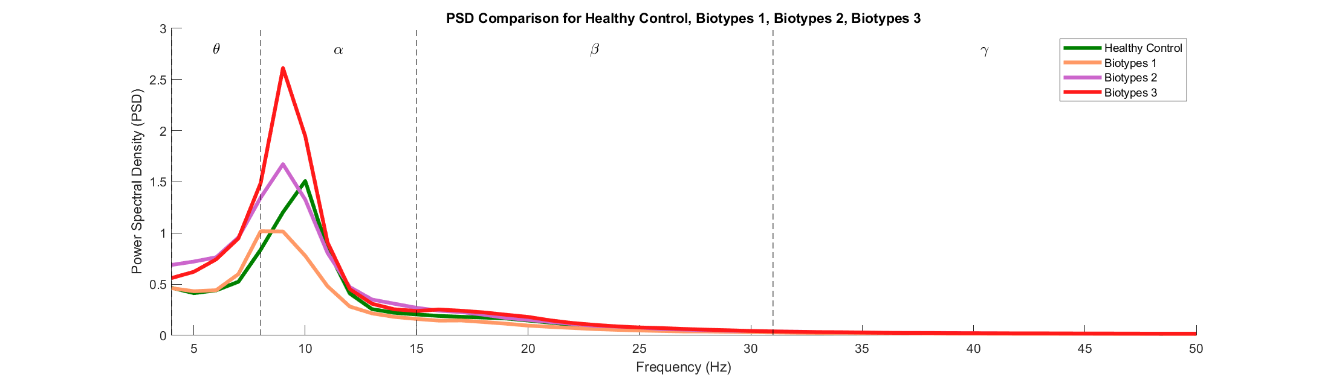
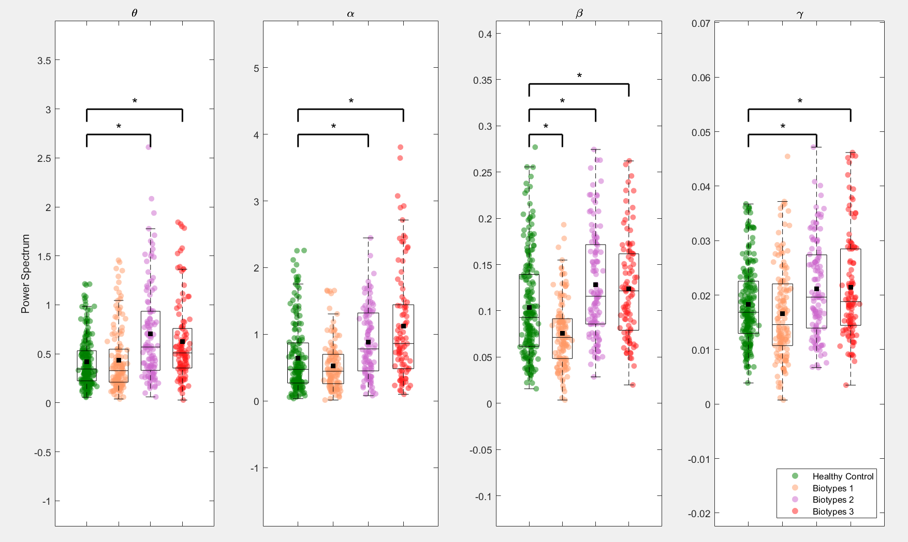
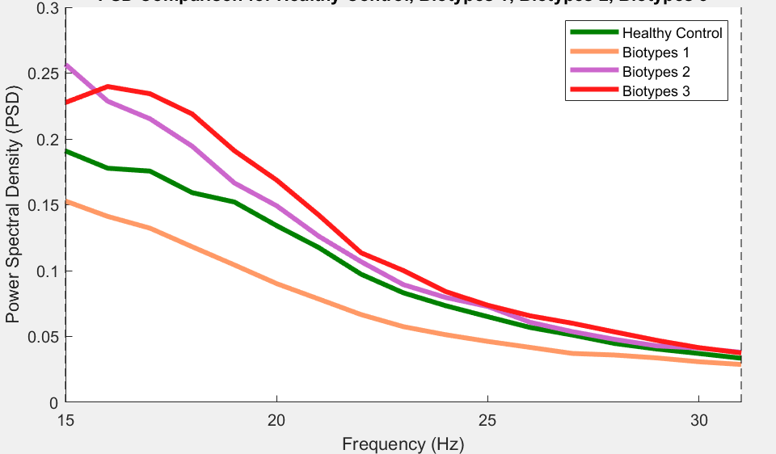
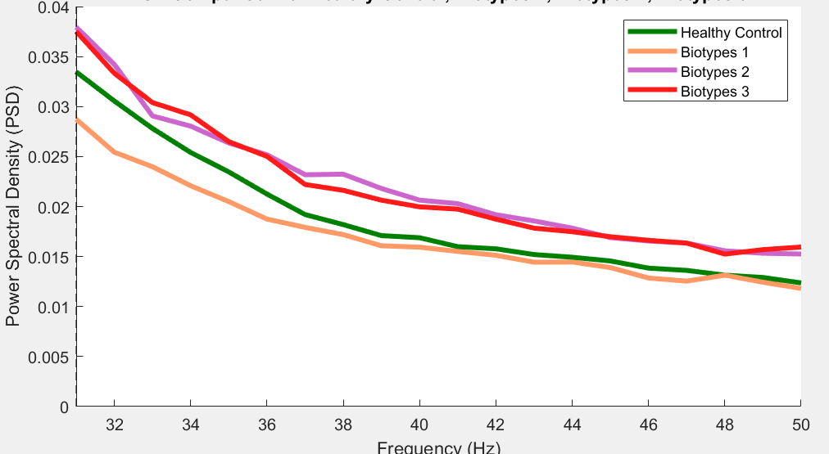
Power Spectrum Analysis
ANOVA and Tukey's HSD (p<0.05)

Slide 8
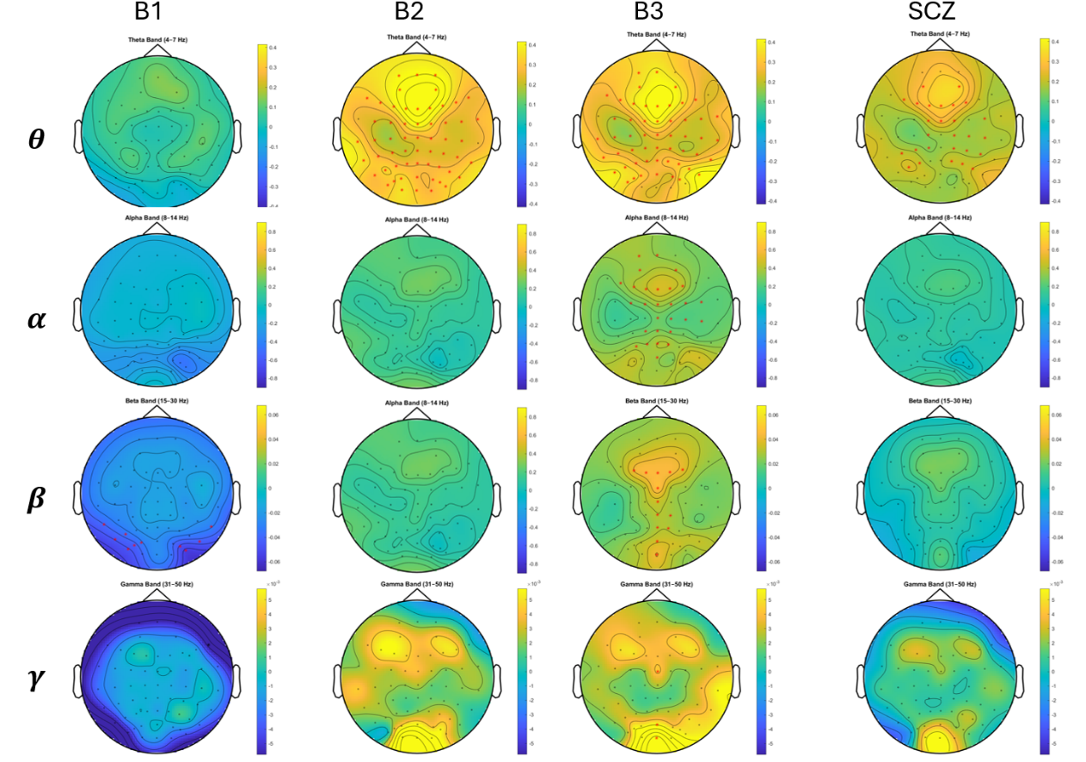
Sensor-Level Analysis

Slide 9
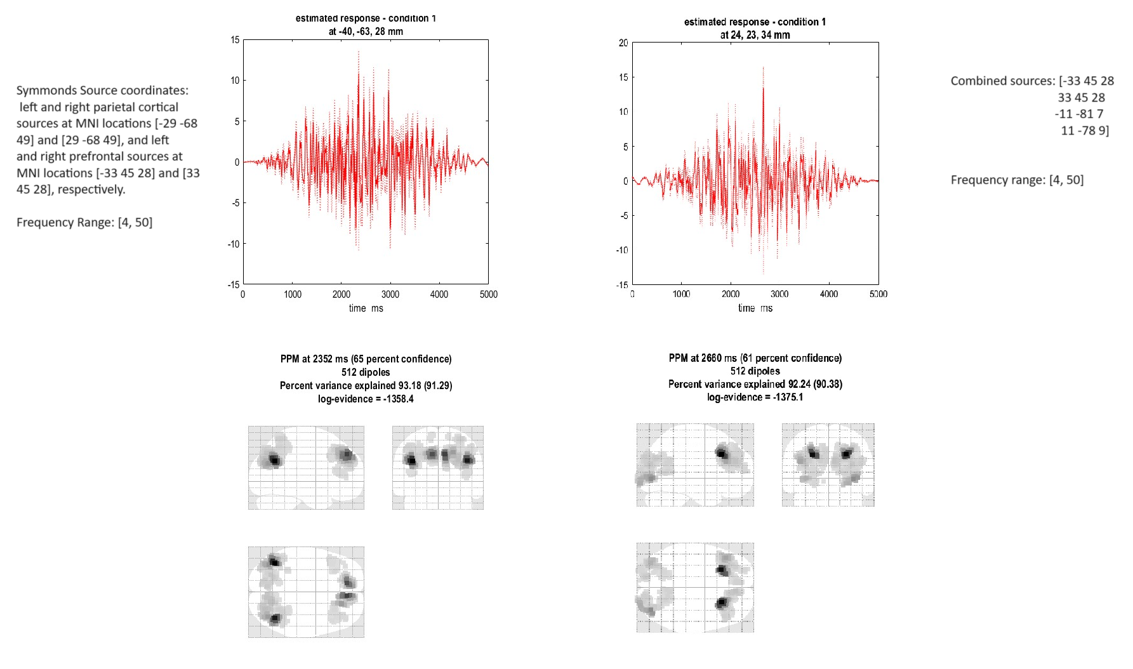
Source reconstruction
Multiple Sparse Priors - incorporates prior knowledge to improve the accuracy of localizing neural activity from EEG data.
Symmonds, M., Moran, C., Leite, M., Buckley, C., Irani, S., Stephan, K., Friston, K., & Moran, R. (2018). Ion channels in EEG: isolating channel dysfunction in NMDA receptor antibody encephalitis.
Tineke Grent-'t-Jong, Joachim Gross, Jozien Goense, Michael Wibral, Ruchika Gajwani, Andrew I Gumley, (2018) Resting-state gamma-band power alterations in schizophrenia reveal E/I-balance abnormalities across illness-stages eLife 7:e37799

Slide 10
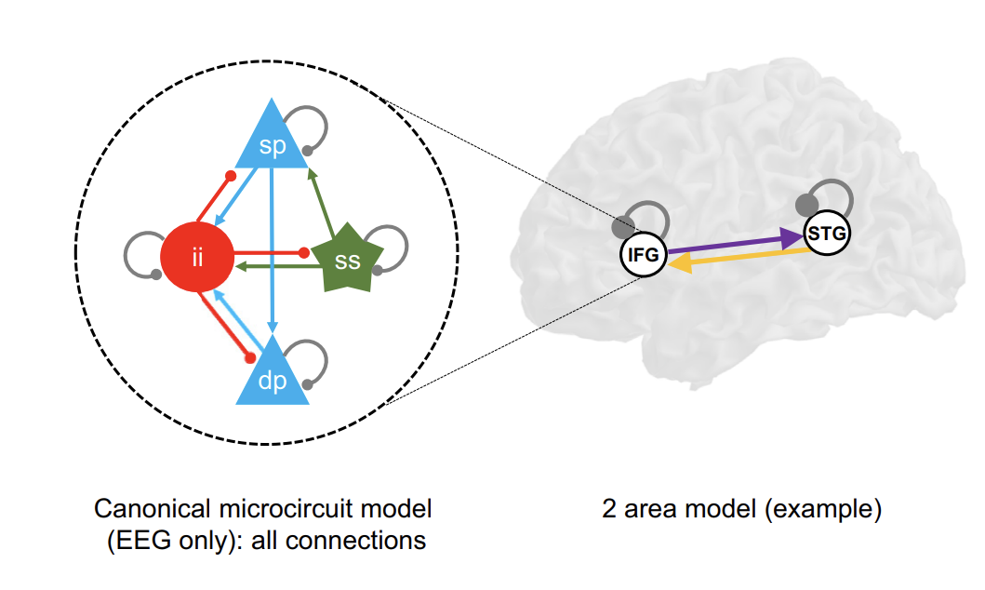
Dynamic Causal Modeling
PFC
PC
Adams, R.A. et al. (2022) ‘Computational modeling of Electroencephalography and functional magnetic resonance imaging paradigms indicates a consistent loss of pyramidal cell synaptic gain in schizophrenia’, Biological Psychiatry, 91(2), pp. 202–215. doi:10.1016/j.biopsych.2021.07.024.

Slide 11
Neural mass model in DCM
Canonical Microcircuit (CMC) Model
ii
sp
dp
ss
Inhibitory interneurons (regulatory layer)
Superficial pyramidal cells (output layer)
Deep pyramidal cells (output and feedback layer)
Spiny stellate cells (input layer)

Slide 12
Neural mass model in DCM
Canonical Microcircuit (CMC) Model
sp
ii
ss
dp

Slide 13
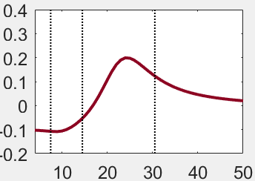
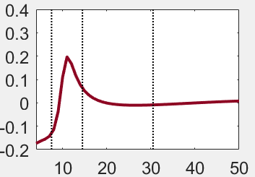
Simulation
1
Increased synaptic time constant
Decreased slope of the activation function
2
Slow the synaptic response and shaped the timing of neuronal firing
Reduce neuronal responsiveness
1
2

Slide 14
Neural mass model in DCM
Canonical Microcircuit (CMC) Model
sp
ii
ss
dp

Slide 15
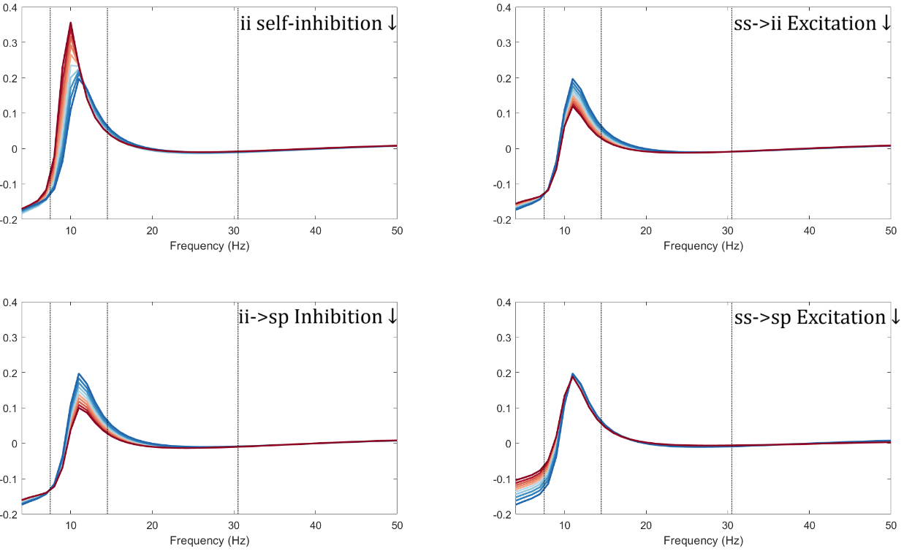
Simulation
sp
sp
ii
ss
ii
ss
dp
dp
sp
sp
ii
ss
ii
ss
dp
dp

Slide 16
Simulation results
Connection | Effect | Result (Spectral Impact) | Biotype
ii → ii (Self-Inhibition ↓) | Reduced inhibition among inhibitory interneurons | More Theta and Alpha power | Biotype 3
ss → ii (Excitation ↓) | Reduced excitation from spiny stellate cells to inhibitory interneurons | More Theta power Less Alpha power | Biotype 1
ii → sp (Inhibition ↓) | Reduced inhibition from inhibitory interneurons to superficial pyramidal cells | More Theta power Less Alpha power | Biotype 1
s → sp (Excitation ↓) | Reduced excitation from spiny stellate cells to superficial pyramidal cells | More Theta power | Biotype 2, Biotype 3

Slide 17
Limitation and Improvements
Limitation | Improvement
Limited Beta/Gamma Effects in Simulation | Fine-tune parameters.
DCM Based on Canonical Microcircuit | Use alternative Models with different structure.
Lack of Longitudinal Analysis | Include longitudinal data and consider age effects.
Manual Parameter Optimization | Implement automatic parameter optimization techniques.

Slide 18
Thanks for listening!

Slide 19
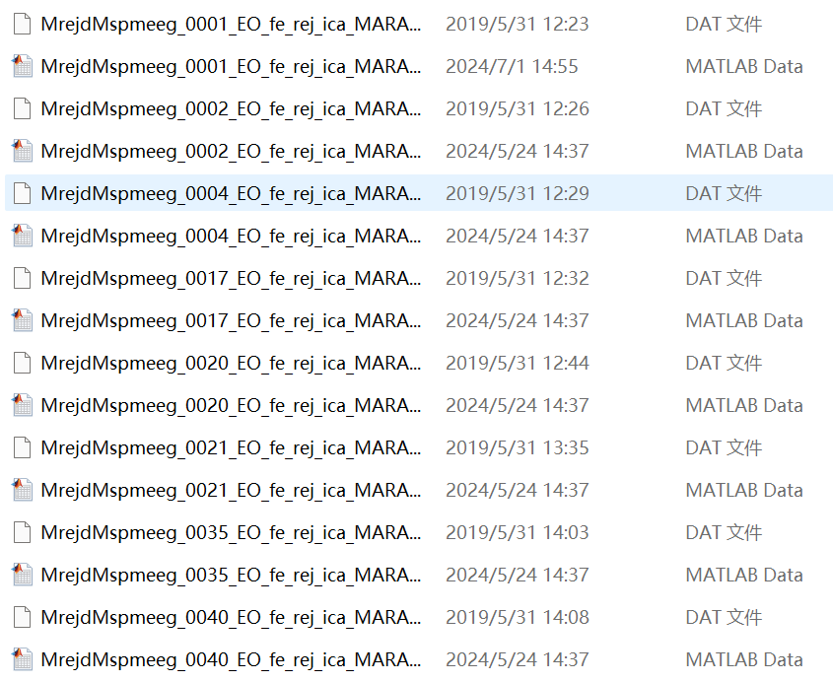
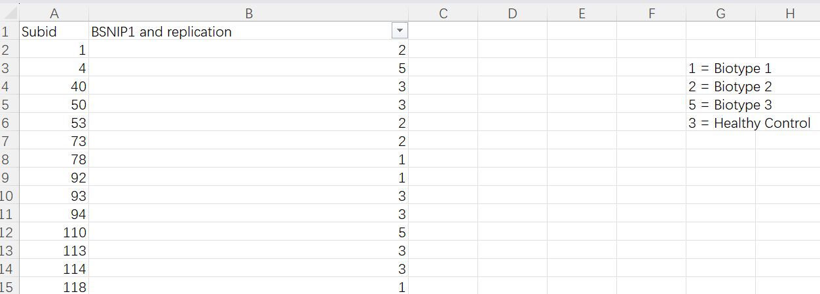
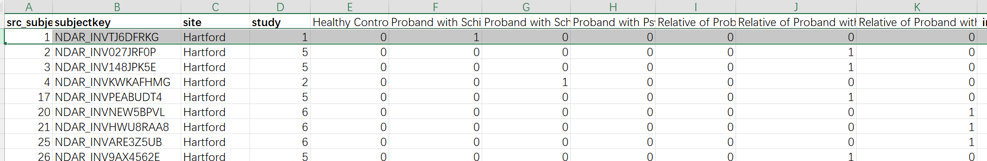
Biotypes

